Slide 1
Securing UNIX
John Johnson
Notes:
Kishan
Sears
Garret
Brett
James
Nathan
Ryan
danny

Slide 2
User Accounts
Change all passwords
#Generate a list of users
awk -F':' '$2 != "*" {print $1}' /etc/shadow > users.txt
#Change every user’s password
for user in `cat users.txt`; do echo $user’:[password]’ | chpasswd; done
Change root password
passwd

Slide 3
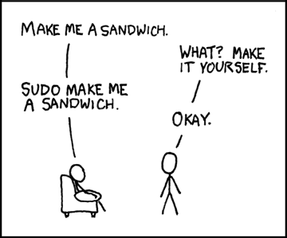
Sudoers
Sudoers list
/etc/sudoers
/etc/sudoers.d folder
root ALL=(ALL) ALL
Remove others as sudo

Slide 4
System Hardening
OS updates
apt-get update && apt-get upgrade
yum update
No users with UID of 0
awk -F: '($3 == "0") {print}' /etc/passwd
No empty passwords
awk -F: '($2 == "") {print}' /etc/shadow
No world writeable files
find /dir -xdev -type d \( -perm -0002 -a ! -perm -1000 \) –print
No Files without owner
find /dir -xdev \( -nouser -o -nogroup \) –print
Every folder should be owned by root as a rule, apply exceptions as needed
chmod –R . 774 for appropriate folders
SSH on non-standard port
MADCRAPS reverse shell

Slide 5
Finding Malware
Connections
Processes
Files
Scheduled Tasks
New users

Slide 6
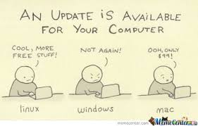
Open Connections
netstat
–plant
-planu
SSH
who –a
TTY
Different OS types have different session log files, but they all have one

Slide 7

Open Connections Cont.
Local Address
Look for ports on your machine
Need to correspond to services you are running
You are not running a service on port 1337
Remote Address
Is address on local network (192.168.X.X)
If it is not, write down address and put it on board

Slide 8
Processes/Executables
Linked to connections
Delete executable
kill -9 [PID]
Write name down
/bin/sh or /bin/bash
Startup
systemctl list-unit-files --type=service | grep enabled
systemctl disable service_name

Slide 9

Executables Cont.
Ps / ps aux
kill -9 [PID]
# yum list installed # yum list packageName # yum remove packageName OR # dpkg –list
# dpkg –get-selections # dpkg --info packageName # apt-get remove packageName

Slide 10
Executables Cont.
# chkconfig --list | grep '3:on' To disable service, enter: # service serviceName stop # chkconfig serviceName off
Outdated services can be exploited
Stop them from running
Leave them available in case of inject

Slide 11
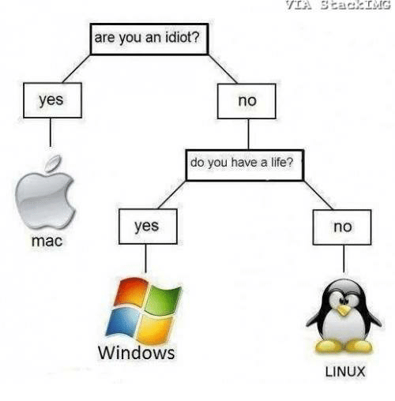
Filesystem
Check tmp folder
/tmp
find “/bin/(ba)sh”
find / | grep [needle]

Slide 12

Scheduled Tasks
Crontab
important to note current user
crontab –l
crontab –e
Cron folders
/var/spool/cron/crontabs
/etc/cron.d
/etc/crontab
/etc/cron.hourly
/etc/cron.daily
/etc/cron.weekly*
/etc/cron.monthly*
/etc/rc.local

Slide 13
New Users
Create original list
cat /etc/passwd > user.txt
Continually create new list and diff
cat /etc/passwd > user2.txt
diff user.txt user2.txt

Slide 14

Firewall
Make sure it’s on
Whitelist rdp (to/from) our host machines
1 port, several IPs
Whitelist list of services (to/from)
Everything else should be closed
iptables

Slide 15
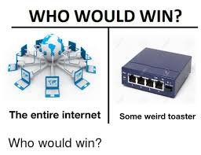
IPTABLES
https://support.rackspace.com/how-to/introduction-to-iptables/
clear old rules
implement firewall
Process to save rules

Slide 16
Services
May have passwords of their own
mysql
Configuration Files
Vulnerabilities

Slide 17
Continuous actions
Firewall
Malware
Users
Services

Slide 18
Finding Malware Initially
Get rid of it
Write down the incident
Blacklist necessary IPs

Slide 19
Finding Malware After Hardening
Get rid of it
Write down the incident
Change all passwords again
Figure out how they got in
Blacklist necessary IPs

